Slide 1


High Probability Streaming Lower Bounds for $𝔽_{2}$ Estimation
William Swartworth
CMU
David P. Woodruff
CMU, Google Research
Samson Zhou
Texas A&M

Slide 2




Streaming Model
Input: Elements of an underlying data set $S$, which arrives sequentially
Output: Evaluation (or approximation) of a given function
Internet traffic
Sensor networks
Stock markets

Slide 3
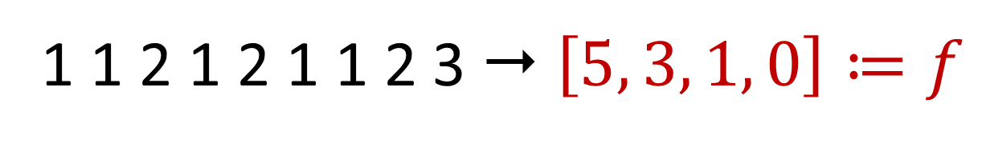
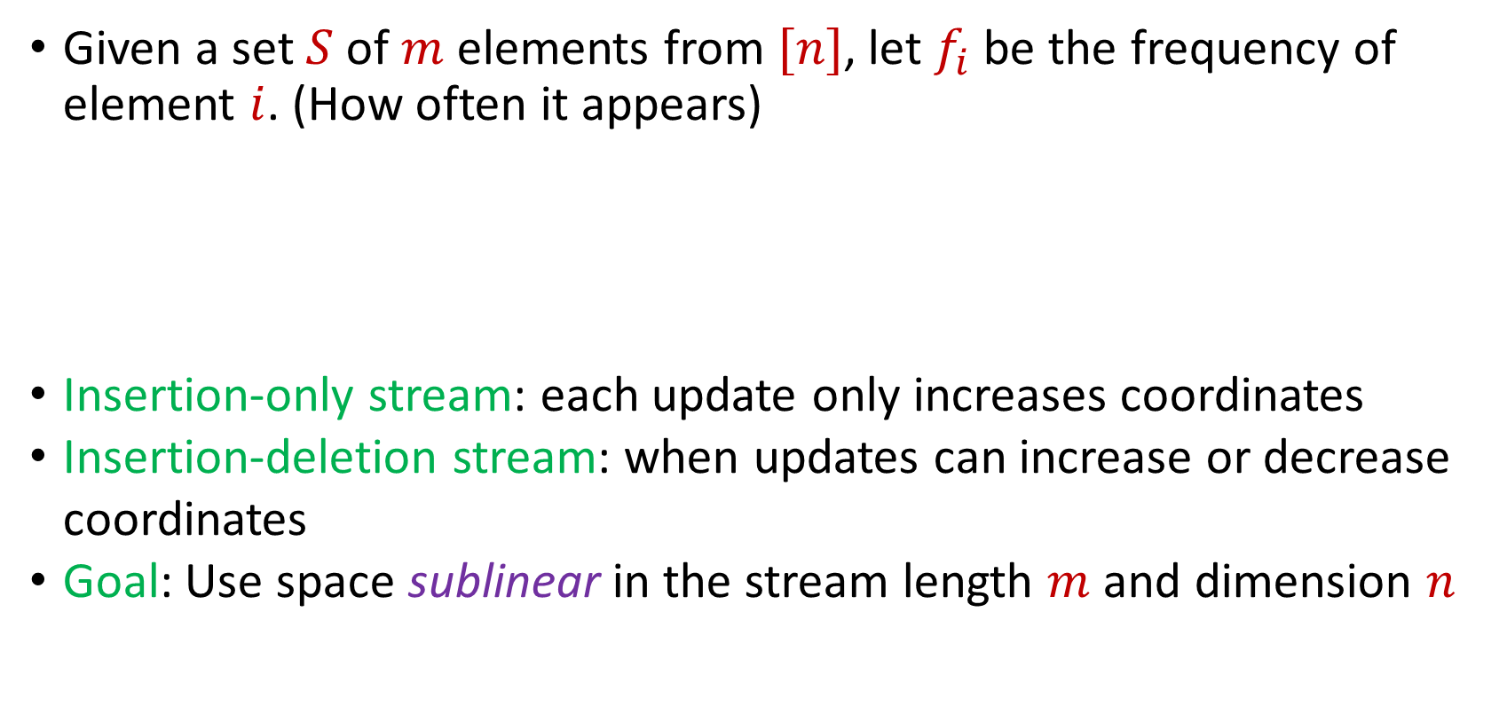
Frequency Vector
Given a set $S$ of $m$ elements from $[n]$, let $f_{i}$ be the frequency of element $i$. (How often it appears)
Insertion-only stream: each update only increases coordinates
Insertion-deletion stream: when updates can increase or decrease coordinates
Goal: Use space sublinear in the stream length $m$and dimension $n$
1 1 2 1 2 1 1 2 3  $\left[5, 3, 1, 0\right]≔f$

Slide 4

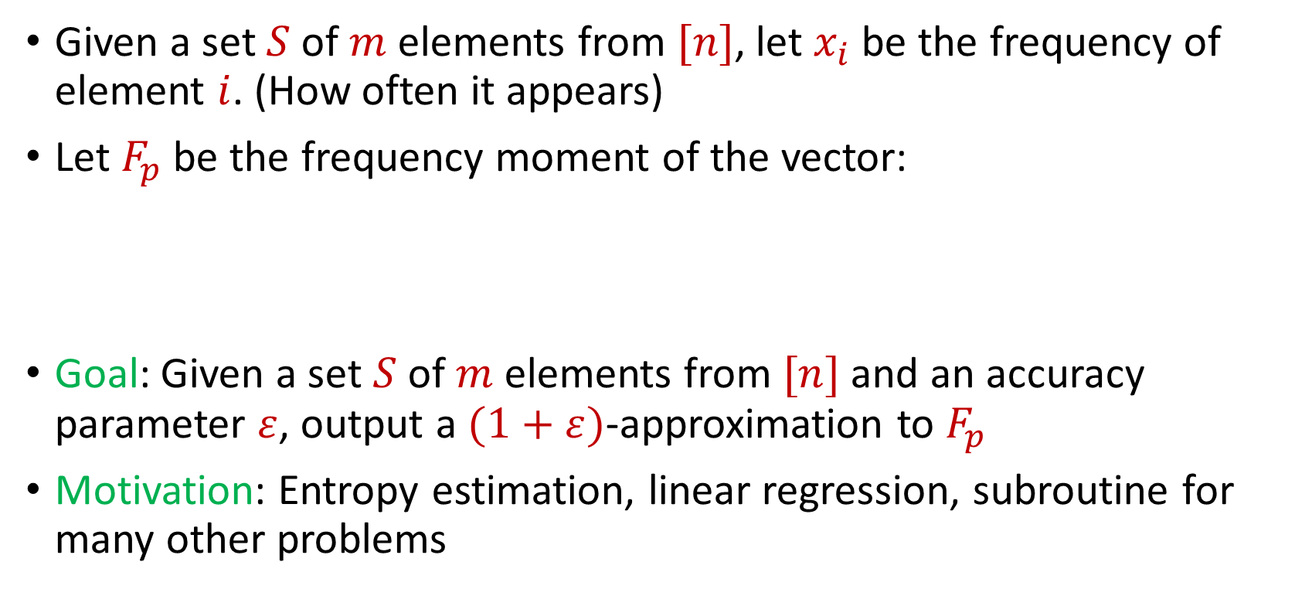
Frequency Moments
Given a set $S$ of $m$ elements from $[n]$, let $x_{i}$ be the frequency of element $i$. (How often it appears)
Let $F_{p}$ be the frequency moment of the vector:
Goal: Given a set $S$ of $m$ elements from $[n]$ and an accuracy parameter $ε$, output a $(1+ε)$-approximation to $F_{p}$
Motivation: Entropy estimation, linear regression, subroutine for many other problems
$$F_{p}={\left|x_{1}\right|}^{p}+{\left|x_{2}\right|}^{p}+ …+{\left|x_{n}\right|}^{p}$$

Slide 5
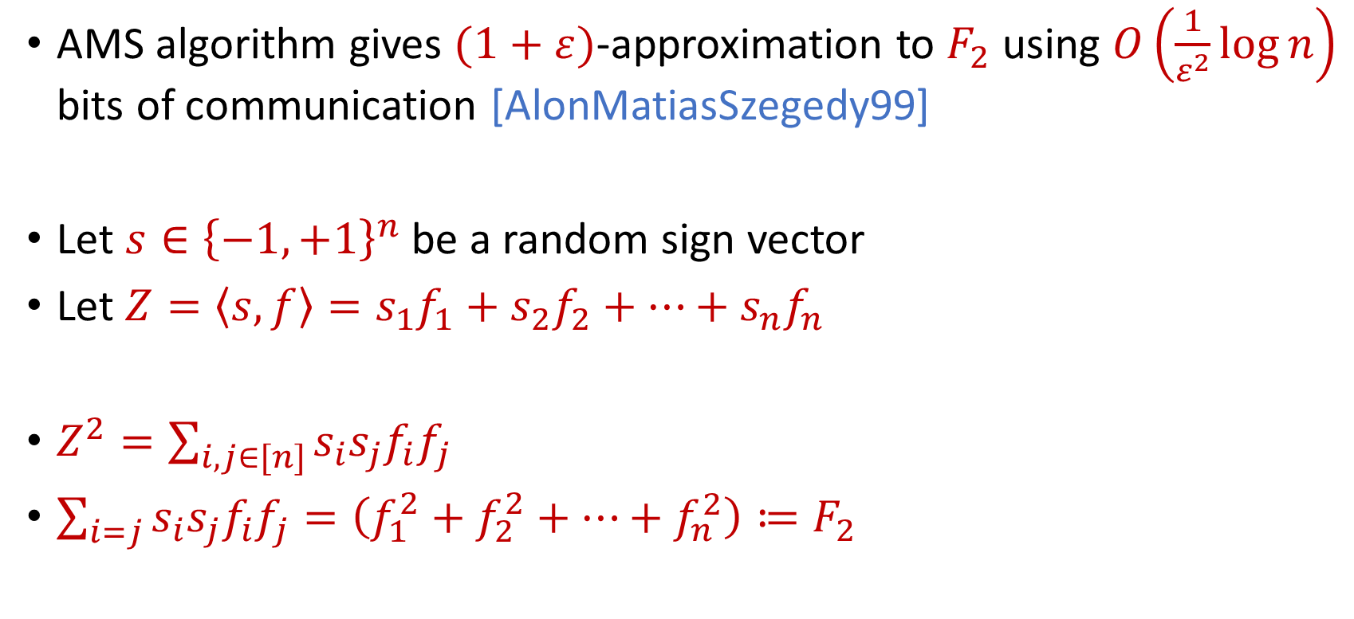
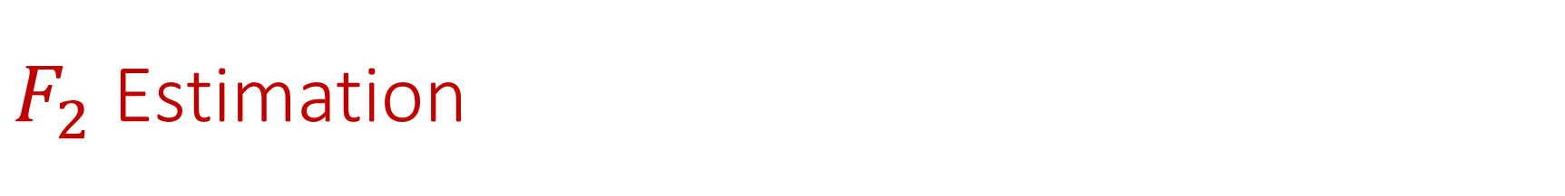
$F_{2}$ Estimation
AMS algorithm gives $(1+ε)$-approximation to $F_{2}$ using $O\left(\frac{1}{ε^{2}}\log{n}\right)$ bits of communication [AlonMatiasSzegedy99]
Let $s∈{\left\{−1,+1\right\}}^{n}$ be a random sign vector
Let $Z=\left\langle s,f\right\rangle =s_{1}f_{1}+s_{2}f_{2}+…+s_{n}f_{n}$
$Z^{2}=\sum_{i,j∈[n]}{s_{i}s_{j}f_{i}f_{j}}$
$\sum_{i=j}{s_{i}s_{j}f_{i}f_{j}}=\left(f_{1}^{2}+f_{2}^{2}+…+f_{n}^{2}\right)≔F_{2}$

Slide 6
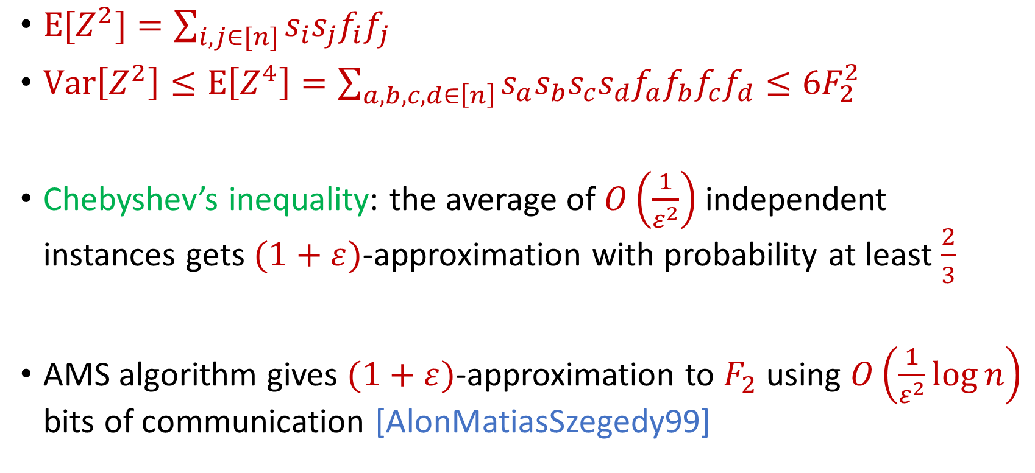
AMS Algorithm
$E[Z^{2}]=\sum_{i,j∈[n]}{s_{i}s_{j}f_{i}f_{j}}$
$Var\left[Z^{2}\right]≤E\left[Z^{4}\right]=\sum_{a,b,c,d∈\left[n\right]}{s_{a}s_{b}s_{c}s_{d}f_{a}f_{b}f_{c}f_{d}}≤6F_{2}^{2}$
Chebyshev’s inequality: the average of $O\left(\frac{1}{ε^{2}}\right)$ independent instances gets $(1+ε)$-approximation with probability at least $\frac{2}{3}$
AMS algorithm gives $(1+ε)$-approximation to $F_{2}$ using $O\left(\frac{1}{ε^{2}}\log{n}\right)$ bits of communication [AlonMatiasSzegedy99]

